Slide 1
Communication Models
Lec Uzma Ehsan

Slide 2
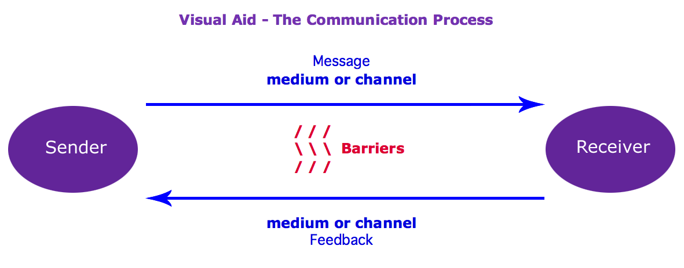
Linear Model of Communication

Slide 3

Linear Model of Communication
The speaker—the sender, the encoder, or source of the message.
The Speaker

Slide 4
Linear Model of Communication
Encoding—the process of putting ideas into symbols to carry a message.
The Speaker
The Speech Text

Slide 5
Linear Model of Communication
Message—ideas communicated verbally and nonverbally.
The Speaker | The Message A speaker sends a message to a listener.

Slide 6

Linear Model of Communication
Listener—the receiver or decoder of the message
The Speaker | The Message A speaker sends a message to a listener.

Slide 7
Linear Model of Communication
Decoding—the process of attaching meanings to symbols received.
Decoding
The Speaker | The Message A speaker sends a message to a listener.

Slide 8
Linear Model of Communication
The speaker—the sender, the encoder, or source of the message.
Encoding—the process of putting ideas into symbols to carry a message.
Message—ideas communicated verbally and nonverbally.
Listener—the receiver or decoder of the message
Decoding—the process of attaching meanings to symbols received.

Slide 9
Linear Model of Communication
The Speaker | The Message A speaker sends a message to a listener. | The Listener

Slide 10
Problems with Linear Model of Communication
#1—The assumption that a person is either the sender or a receiver of messages.
Actually, we perform both of these roles simultaneously.

Slide 11
Problems with Linear Model of Communication
#2—The suggestion that communication involves only one message.
Actually, there are as many messages as there are communicators involved, and the message the sender intends is never identical to the one received.

Slide 12
Interactive Model of Communication
When scholars began to see the limitations of the linear model of communication, they added other components to the speaker, message, and listener making a total of 7 components:
channel, feedback, environment, and noise

Slide 13
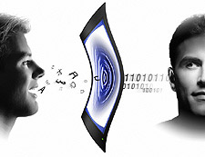
Interactive Model of Communication
Channel—the medium, or the way the message is sent.

Slide 14
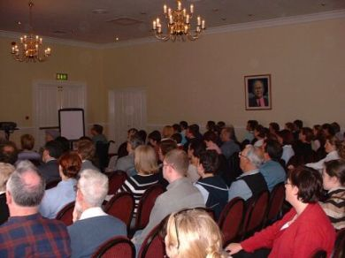
Interactive Model of Communication
Feedback—includes all messages, verbal and nonverbal, sent by listeners to speakers.

Slide 15
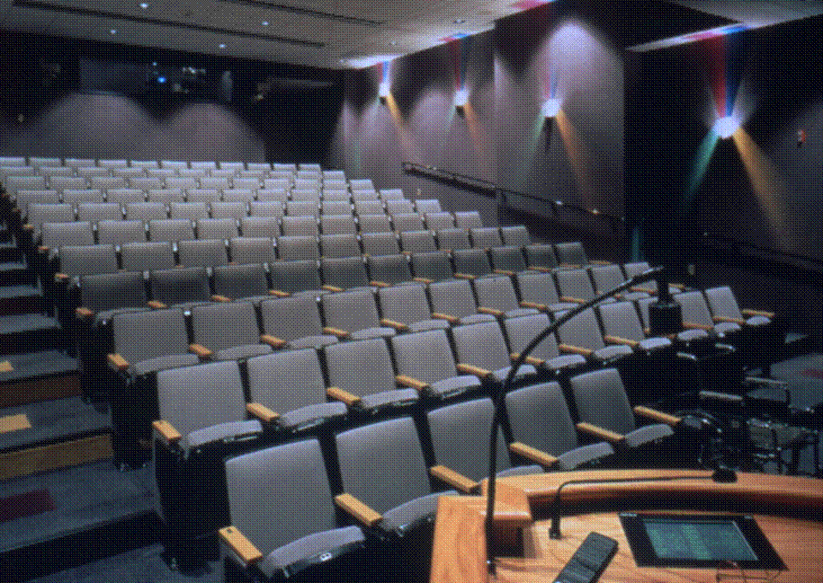

Interactive Model of Communication
Environment—the physical setting and the occasion for communication.

Slide 16

Interactive Model of Communication
Noise—anything that distracts from effective communication; some form of noise is always present.

Slide 17
Interactive Model of Communication
Channel—the medium, or the way the message is sent.
Feedback—includes all messages, verbal and nonverbal, sent by listeners to speakers.
Environment—the physical setting and the occasion for communication.
Noise—anything that distracts from effective communication; some form of noise is always present.

Slide 18

Noise
Physical noise—distractions originating in the communication environment.

Slide 19

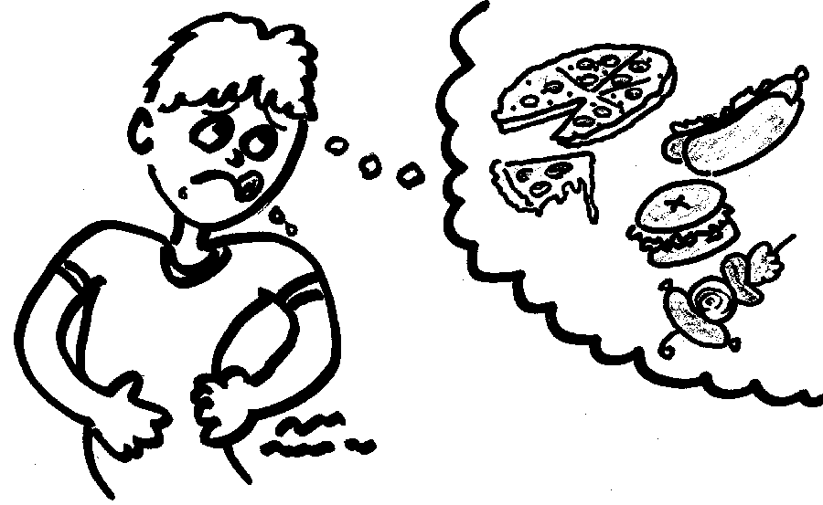

Noise
Physiological noise—distractions originating in the bodies of communicators—cold, headache, hunger, fatigue.

Slide 20

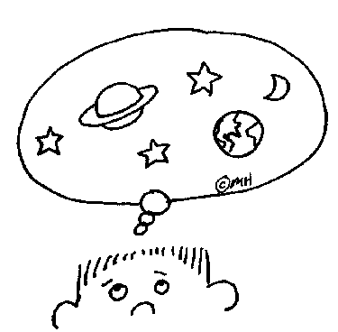
Noise
Psychological noise—distractions originating in the thoughts of communicators—anxiety, daydreaming, worry.

Slide 21
Noise
Physical noise—distractions originating in the communication environment.
Physiological noise—distractions originating in the bodies of communicators—cold, headache, hunger, fatigue.
Psychological noise—distractions originating in the thoughts of communicators—anxiety, daydreaming, worry.

Slide 22
CHANNEL
Message
SPEAKER
LISTENER
Decoder
Encoder
Environment
Environment
Noise
Noise
Noise
Decoder
Encoder
Feedback
Interactive Model of Communication
CHANNEL

Slide 23
CMAPP Model of Communication
Context
Audience
Message
Purpose
Product

Slide 24
THE CMAPP APPROACH
Context
Message
Audience
Purpose
Product

Slide 25
Context
Context refers to the surrounding situation. It may include (but is limited to):
- Personal relationship.
- Time and place.
- All circumstances that may influence the people and the communication
involved.
- External and internal interference that might have an impact.

Slide 26
Message
Message refers to the content of the communication, and might include:
- An overview of the situation.
- The most significant fact, issue, and questions.
- Relevant details.
- A primary message (the main thing you wish to communicate) and, potentially,
a secondary message (ideas that might appear in parentheses).

Slide 27
Audience
Audience is similar to the receiver in the transactional models. Here, however, it can include:
- A primary audience, which refers to the person or people you want to reach first.
- A secondary (and perhaps even a tertiary) audience, which refers to other people you wish to reach as well (e.g., your boss's boss, the manager who receives a copy of all interoffice memos, your facilitator when you are delivering a presentation to your class. )

Slide 28
Purpose
Purpose refers to why you are communicating, the concept includes:
- Your motive or motives – potentially, both overt and covert – for communicating.
- The possibility of secondary (and perhaps even a tertiary) purpose.
- The reaction that you except from your audience.
- The response you wish to elicit.

Slide 29
Product
Product is the "shape" of communication, or the physical form it takes (e.g., a particular appearance on paper). The choice of paper will affect and be affected by the context, message, audience, and purpose. Thus the term would include (but not be limited to):
Memos Letters
Reports Summaries
Faxes E-mails
Telephone conversations
Face to face conversations

Slide 30
Lets have a quick recap

